Slide 1

Greedy Algorithm

Slide 2
Coin change Greedy Algorithm
input : change W
output : The minimum number of coin
change = W, n16=n10=n5=n1=0
while(change≥ 16) change = change-16, n16++
while(change≥ 10 ) change = change-10 n10+
while(change≥ 5 ) change = change-5 n5+
while(change≥ 1) change = change-1, n1++
return(n16+n10+n5+n1)
(Example) change = 20
line 1 : change = _________, n16=n10=n5=n1=
line 2: _____ ≥ 16 change = n16= , n10= , n5= , n1=
line 3: _____ ≥ 10 change = n16= , n10= , n5= , n1=
line 4: _____ ≥ 5 change = n16= , n10= , n5= , n1=
line 5: _____ ≥ 1 change = n16= , n10= , n5= , n1=
line 6: n16+n10+n5+n1=
(Quiz)Change = 39 n16= , n10= , n5= , n1=

Slide 3
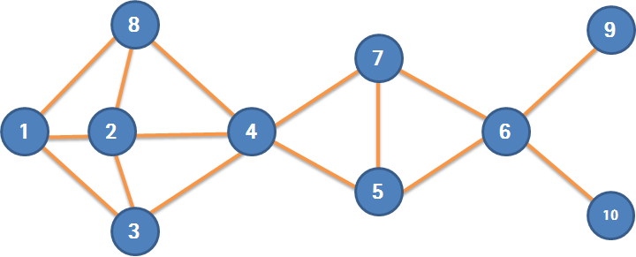
Set Cover Algorithm Greedy Algorithm
input : U,F={Si},i=1,2,....,n
output : SetCover C
C=∅
while (U≠∅) do {
choose S from F that maximizes the cover of elements in U
U=U-Si //subtract S's elements from U
add Si to C
}
return C
U=(1,2,3,4,5,6,7,8,9,10}
F={S1,S2,S3,S4,S5,S6,S7,S8,S9,S10}
S1={1,2,3,8} S2={1,2,3,4,8}
S3={1,2,3,4} S4={2,3,4,5,7,8}
S5={4,5,6,7} S6={5,6,7,9,10}
S7={4,5,6,7} S8={1,2,4,8}
S9={6,9} S10={6,10}

Slide 4



Fractional Knapsack Problem
Example
i = < 1, 2, 3>
w = < 1, 2, 3>
v = < 6, 10, 12 >
W = 5
Input
Items <i1, i2…,in >
Weight <w1, w2, ….,wn>
Values <v1, v2, ….,vn>
Knapsack W Kg
Solutions
Item 1 : 100%, item 2 : 100%, item 3 : 2/3 : Answer
W = 1 + 2 + 2 = 5 Value = 6 + 10 + 12 * 2/3 = 24
Item 1 : 100%, item 3 : 100%, item 2 : 1/2
W = 1 + 3 + 1 = 5 Value = 6 + 12 + 10 * 1/2 = 23
Item 2 : 100%, item 3 : 100%, item 1 : 0%
W = 2 + 3 + 0 = 5 Value = 10 + 12 = 22

Slide 5
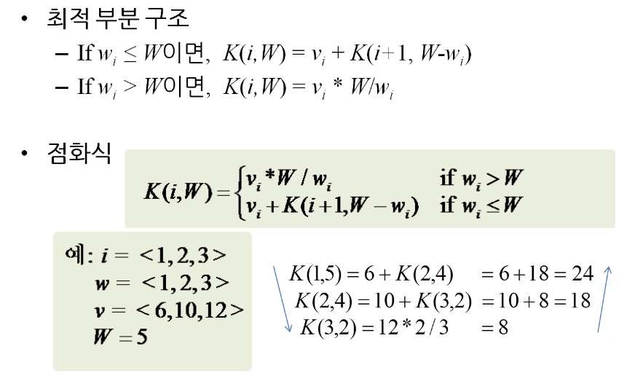
Recursive Algorithm – Fractional Knapsack

Slide 6
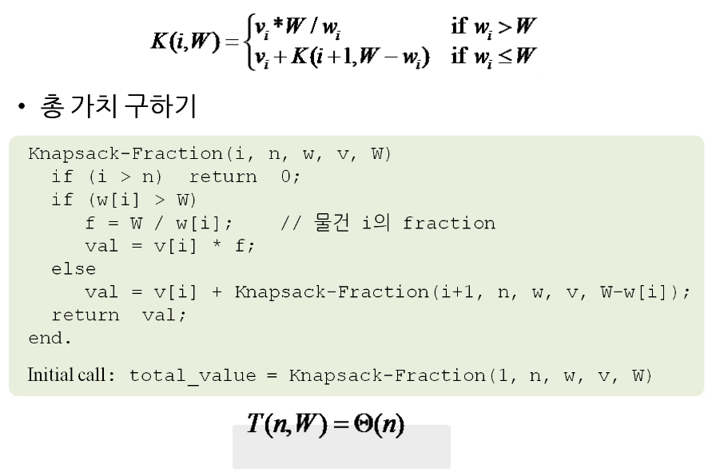
Recursive Algorithm – Fractional Knapsack

Slide 7
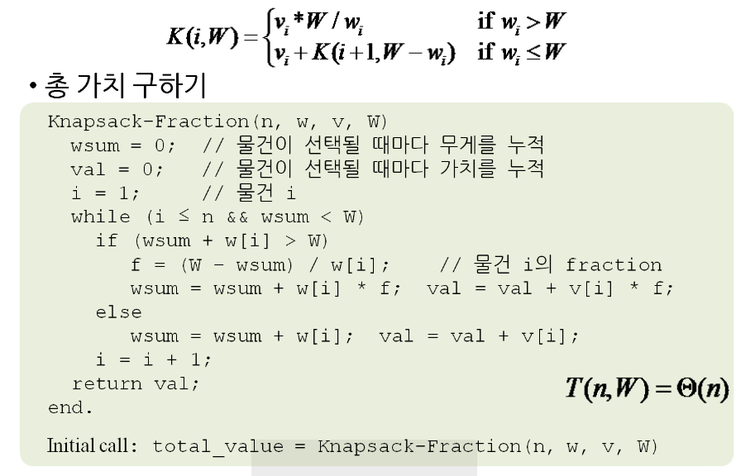
Iterative Algorithm – Fractional Knapsack

Slide 8
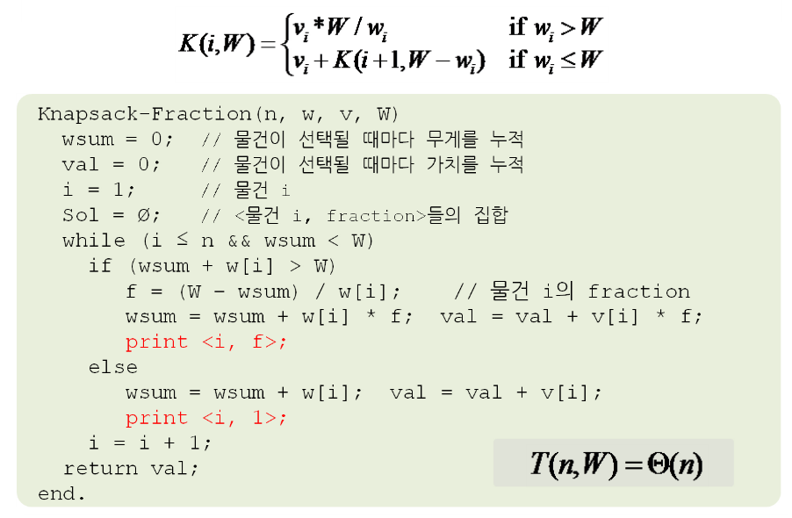
Fractional Knapsack

